Slide 1

Data-Driven Estimation
A Comprehensive CASE Tool Framework for Modern Software Engineering
Dua jamali(65340) & Sohaib Anjum (65309)

Slide 2



Executive Summary
40%
The Problem
The Solution
Manual software cost estimation often leads to severe budget overruns due to subjective bias and a distinct lack of empirical data anchors guiding the development lifecycle.
Our Laravel + React framework actively automates component sizing and applies strict historical anchors to provide highly defensible, mathematically sound budget forecasts.

Slide 3

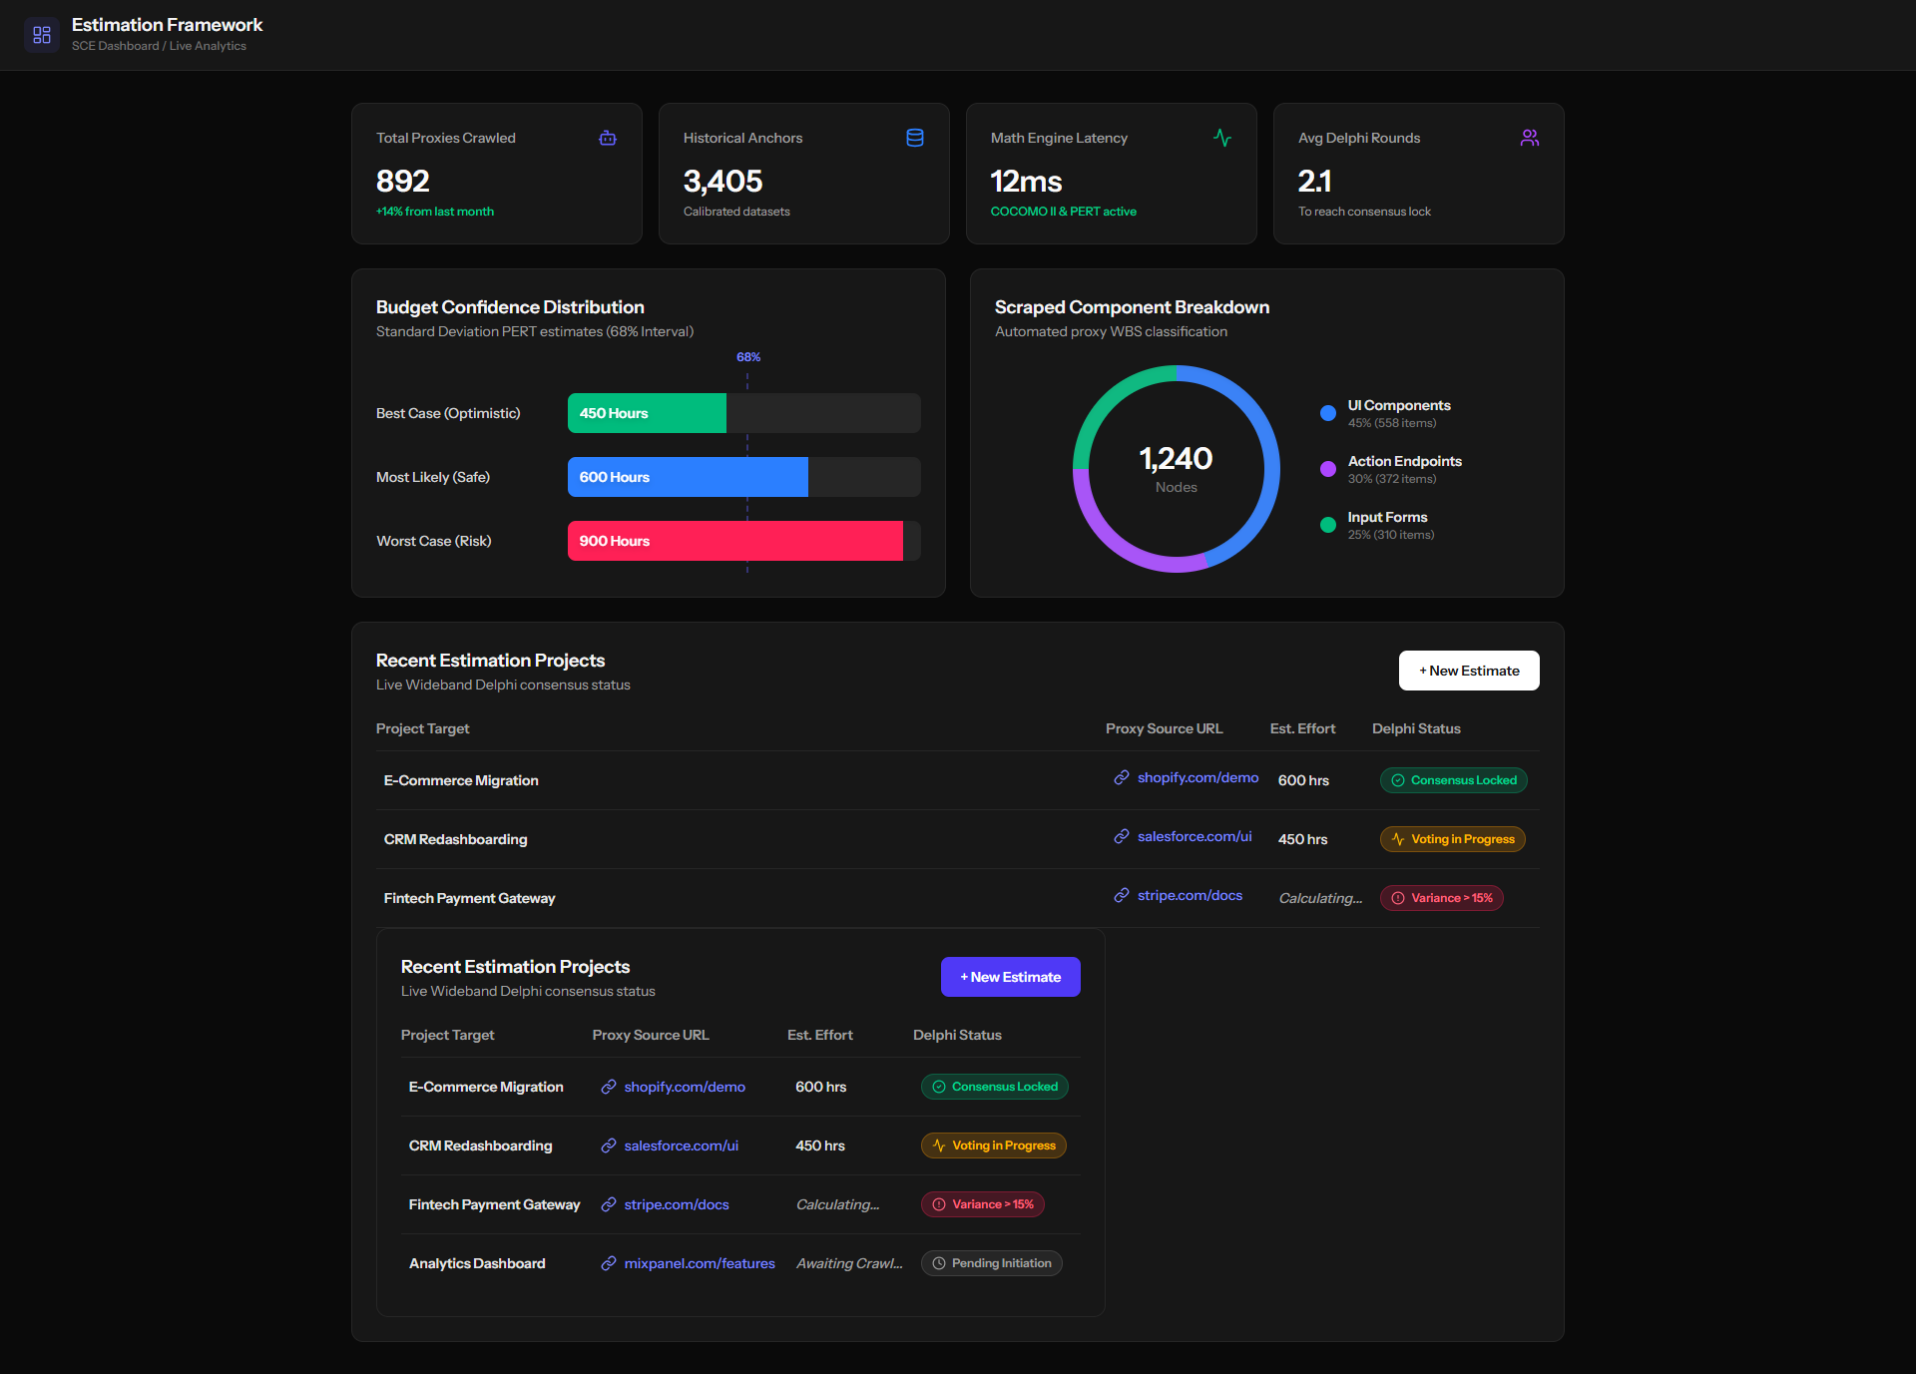
Technical Architecture Stack
Production Grade Stack
The system utilizes a modern decoupled architecture to ensure high-fidelity performance and secure data handling.
Frontend: React 18 for interactive, real-time dashboarding.
Backend: Laravel 11 handling COCOMO mathematical logic.
Crawler: Python nodes for automated sizing and DOM scraping.
Database: PostgreSQL for secure empirical project logs.

Slide 4

Automated Proxy Scraper
Our proxy module scans competitor DOM structures to map interface complexity, identifying Input Forms & Fields, Action Endpoints, and UI Components. How we adapt to scraping trends:
Scraping Trend | Impact on Data Extraction | Framework Adaptation
AI-Powered Defenses | AI-driven bot detection, session tracking, and rate limits make traditional scraping harder. | Use human-like browsing patterns, rotating proxies, and headless browsers.
API-Only Marketplaces | Platforms are blocking traditional DOM scraping and enforcing strict API-based access. | Combine API data payloads with supplementary public UI structure scraping.
Dynamic Pricing/Inventory | Values fluctuate rapidly on modern sites, requiring immediate, real-time syncs. | Implement high-frequency micro-scraping and automated alerts for instant adjustments.

Slide 5


COCOMO II & PERT Calculation Engine
PERT Statistical Risk Modeling
Algorithmic Foundations
Users input range values (Optimistic and Pessimistic) to account for technical uncertainty. The system calculates the weighted average baseline effort.
94% Accuracy
The tool implements COCOMO II scaling factors to adjust for personnel capability, platform complexity, and schedule constraints. Removing human intuition provides highly defensible KLOC and Effort-Month metrics.

Slide 6
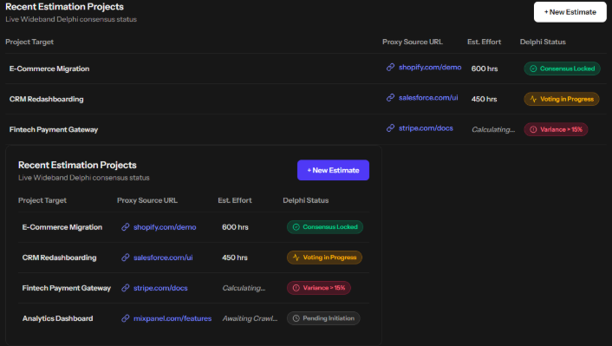

Delphi Consensus
Structured Collaboration
To eliminate developer-specific bias, our tool enforces a strict dual-verification consensus protocol during the estimation process.
Independent Estimation: Dua & Partner estimate modules entirely separately.
Discrepancy Trigger: The system creates automatic flags for values demonstrating > 15% variance.
Lock-in Validation: Final estimation values are committed only upon mutual alignment and debate.

Slide 7

Project Functional Matrix
Domain | Member Lead | Core Tasks
Frontend GUI | Dua (65340) | React state logic, Tailwind layouts, Metrics visuals.
Backend Logic | Partner | Laravel API architecture, PostgreSQL data modeling.
Math Engine | Dua & Team | COCOMO II factors, PERT scripts, Scrapy workers.
Quality QA | Team | Historical anchor validation and Delphi consensus rounds.

Slide 8
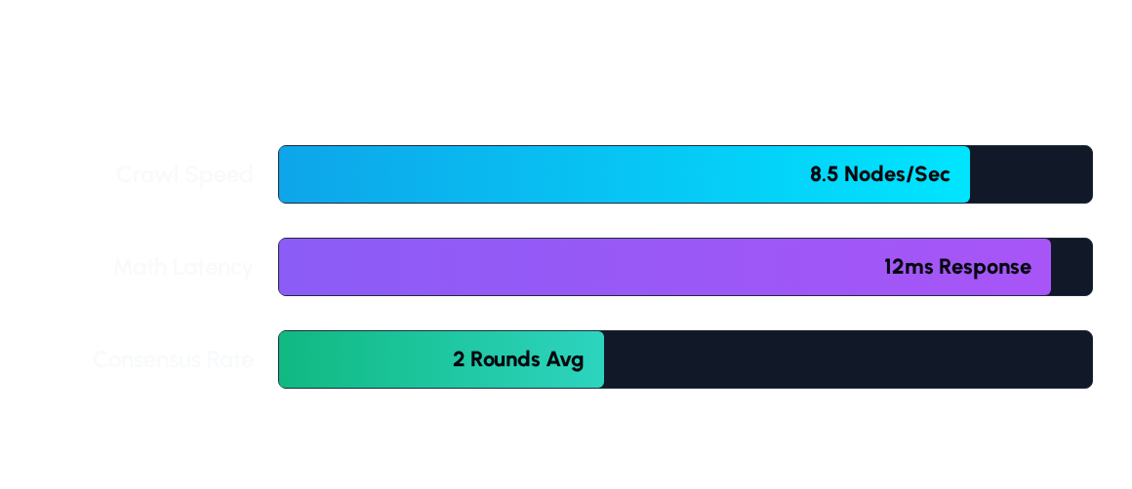
System Performance Comparison
Technical throughput benchmarks for the Laravel-React pipeline

Slide 9
Vision 2026
Integrating Machine Learning for predictive pattern recognition and dynamic effort scaling across globally distributed development clusters.
Questions?
Thank you for your time.
DUA (65340)& Sohaib Anjum(65309) | SOFTWARE COST ESTIMATION TOOL

